Slide 1

DriverPass System Analysis
Michael Steenkamp

Slide 2

System Requirements
Functional Requirements:
The system shall provide three different driving packages to choose from.
The system shall provide different roles that can be assigned to the appropriate users.
Non-Functional Requirements:
The system will have a response time between .1 and .6 seconds.
The system will only allow a single user to have admin/owner role properties.
Notes:
Functional:
There are many functional requirements; however, I believe these are the most important and deserve most of the focus.
“The system shall provide three different driving packages to choose from”:
This is a perfect functional requirement that shows that the system will have three distinct packages that the user can choose from. This supports the DriverPass requirement of having different packages that the user can choose for their service.
“The system shall provide different roles that can be assigned to the appropriate users”:
This functional requirement gives focus to the fact that there will be different users using the system and that they may have different roles. This supports the DriverPass requirement of having different roles for each user, and it also supports the system design of Object Oriented Programming.
Non-Functional:
“The system will have a response time between .1 and .6 seconds”:
We don’t want the system be ‘laggy’, so it should have a response time between 100 and 600 milliseconds. The reason for this time frame is that the average reaction time of a person is over 700 milliseconds so having the system respond at a maximum of 600 milliseconds will ensure that there will not be any noticeable delay.
“The system will only allow a single user to have admin/owner role properties”:
We don’t want many users to have the authority that the admin/owner has because it can cause one crusial problem which is security. Because of this it is essential that there are only the admin/owner role is only given to a maximum of one user.

Slide 3
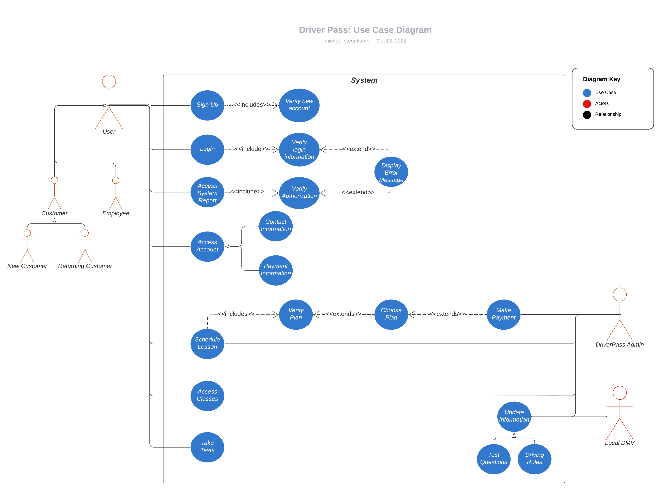
Use Case Diagram
Notes:
To start with we have three main people in this diagram.
We have the user of the system, DriverPass, and the local DMV.
The user has children namely customer and employee.
The customer also has two children, one for a new customer and one for a returning customer.
The user has seven distinct blue circles available to them, we call these blue circles use cases, which are things that the user should be able to do within the system.
The things that the user should be able to do are sign up, login, access system report, access account, schedule lesson, access classes, and take test. Once the user logs in the system will verify the login information and if it is invalid it will then display an error message. The user can access their account and within it they can access their contact and payment information. The user can schedule a driving lesson which will make the system verify that they have a plan; if they don't have a plan then they will be given the option to choose a plan and if they do so, they will be directed to pay. Another thing is accessing classes. The user can take tests as well as access the system report. The system report can only be accessed by authorized user; otherwise, an error message will display.
The DriverPass actor will have access to scheduling driving lesson, making payments, and accessing the classes provided.
The local DMV will be allowed to update information in the system, this information is in two categories, test questions and driving rules/regulations.
We tried to keep all of DriverPass’s requirements in mind. The user will be able to do sing up for an account, log in to an existing account, access their account information, schedule lessons, purchase a plan, access classes, take tests, and of course they can also access the system report if they have the appropriate authentication. The local DMV is also involved in updating the system with the latest information.

Slide 4
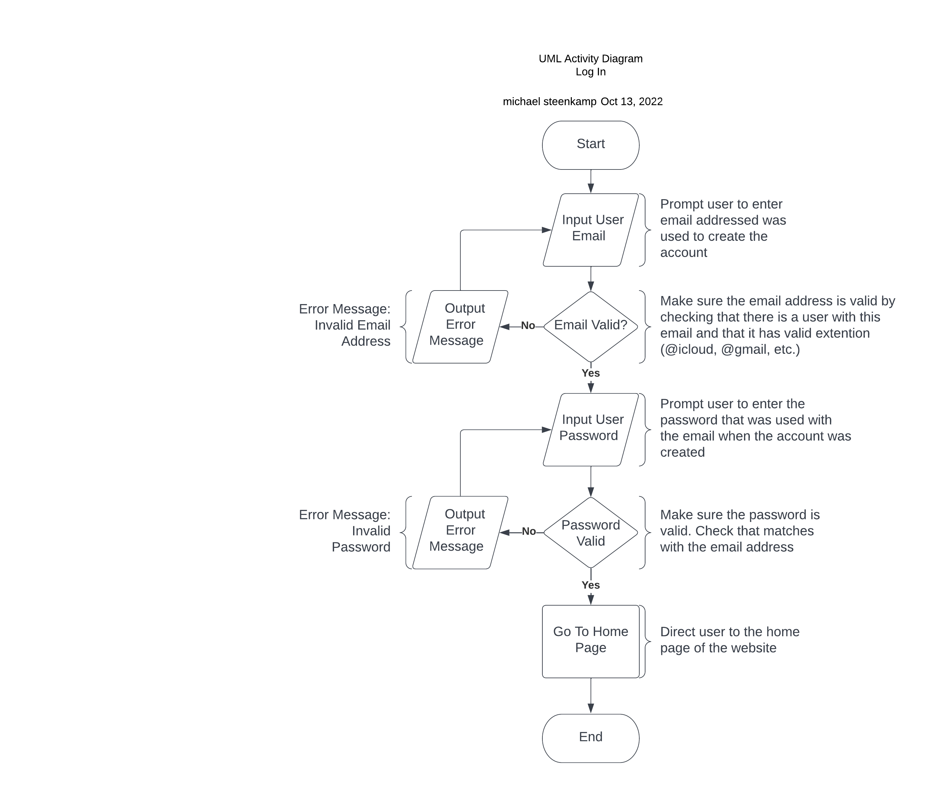
Activity Diagram
Notes:
When we explained the use case diagram there was a blue circle called log in, now this diagram explains that single blue circle in more detail.
Firstly let me explain what is going on here. First we read from top to bottom, when we start the user is prompted to enter their email that they used when they created the account. Next, if the email is valid, meaning that there is a user that uses this email, then the user will be prompted to enter the password that was used with that email. If the email was invalid then the user will just be prompted that the email is invalid, and they will be prompted to enter a valid email. If the password that was entered is invalid then the user will be prompted that the email was invalid and will be asked to try to enter the password again. If the password was valid then the user will be directed to the sites home page.
For this diagram we made sure that the user will be allowed to try and login again if they made a mistake along the way.

Slide 5
Security
Username/Email Required
Password Required
Encryption
No Brute Force
Notes:
Firstly, security is very important and we have planned to take the necessary precautions.
1. Username/Email and Password Required:
For a user to be allowed into their account they will have to provide a username/email and a password. This makes sure that no-one can login to the wrong account on accident.
2. Encryption:
This means that when data is being taken from point A to point B that it looks different. So the only way to know what the data is, is if you have a way to make that funny looking data look normal. Image the data as a pen and encryption as a locked box that you put they pen into, the only way to open the box and get the pen is if you have the right key.
3. No Brute Force:
Basically for this we will just not allow users to try and login more than three failed attempts. This will ensure that no one will try each possible password with an email/username to try and login that way.

Slide 6
System Limitations
Storage Space
Platform
Accessibility
Budget
Features
Notes:
Firstly, since the system is web-based (on the internet) there would need to be a designated server running and soring all the data, this will take a lot of storage space which may be a limitation down the road as more customers use the system.
Another limitation is platform; as for now the system will only be accessible through the internet via an internet browser, this can result in many limitations such as network connections, availability, access to appropriate devices, etc.
Not all potential customers will have access to the internet or devices capable of using internet browsers which will limit the number of customers that DriverPass will receive.
Finally, the budget will be another limitation because as the project increases in size with new features and dependencies the budget will also increase which will result in one of two scenarios, Driverpass is willing to increase the budget thus more features can be added or the scope of the project will have to be reevaluated.

